Slide 1

Dragons of Westeros
Final Project Math 42
Group 1

Slide 2
Dragon Characteristics
We will discuss many differing attempts to model the dragons size based on information combined from the real world and the book series.
Using different models to estimate size in kg of the dragons based on different factors
Food intake based on years
Magical growth factor
Different model flavors with different assumptions
Using the Dragons size, we will estimate the Calories needed to feed a dragon of that size
3 Tiers of sizes (small, large, massive)
Estimate the number of Calories in a primary food source to estimate how many animals will be needed to feed the dragon

Slide 3
Dragon Sizing Models
Linear Growth Model
Constant Growth-Rate Model
Age-Based Growth Model
Logistic Growth Model
Position-Based Model
Logistic Growth with Magical Factor

Slide 4
Dragon Information from Books
The Largest Dragon ever was Balerion from TWoIaF by GRRM
He was the largest dragon ever at an estimated 7000kg (*)
The dragon Drogon from the Books is estimated to be 18 years old in the game of thrones finale’, at an estimated 1800kg
No model without a special assumption could model this insane growth, therefore magical assumptions are made in the model presented
The prompt states that the dragons start at 10kg in year one and 30-40kg in year 2
The average dragon reaches a near full size around 150 years old, and live on average to old -age around 250 years old
The models are based on this assumption, that an average dragon reaches ~7000kg at 150 years old without interference

Slide 5
Estimates of Dragon Size
The size of the 1500kg Dragon size can be found online with these estimates
https://www.youtube.com/watch?v=_q7_37YcvKs
The above also details the size of the largest dragon allowing us to scale up to the 7000kg dragon.

Slide 6
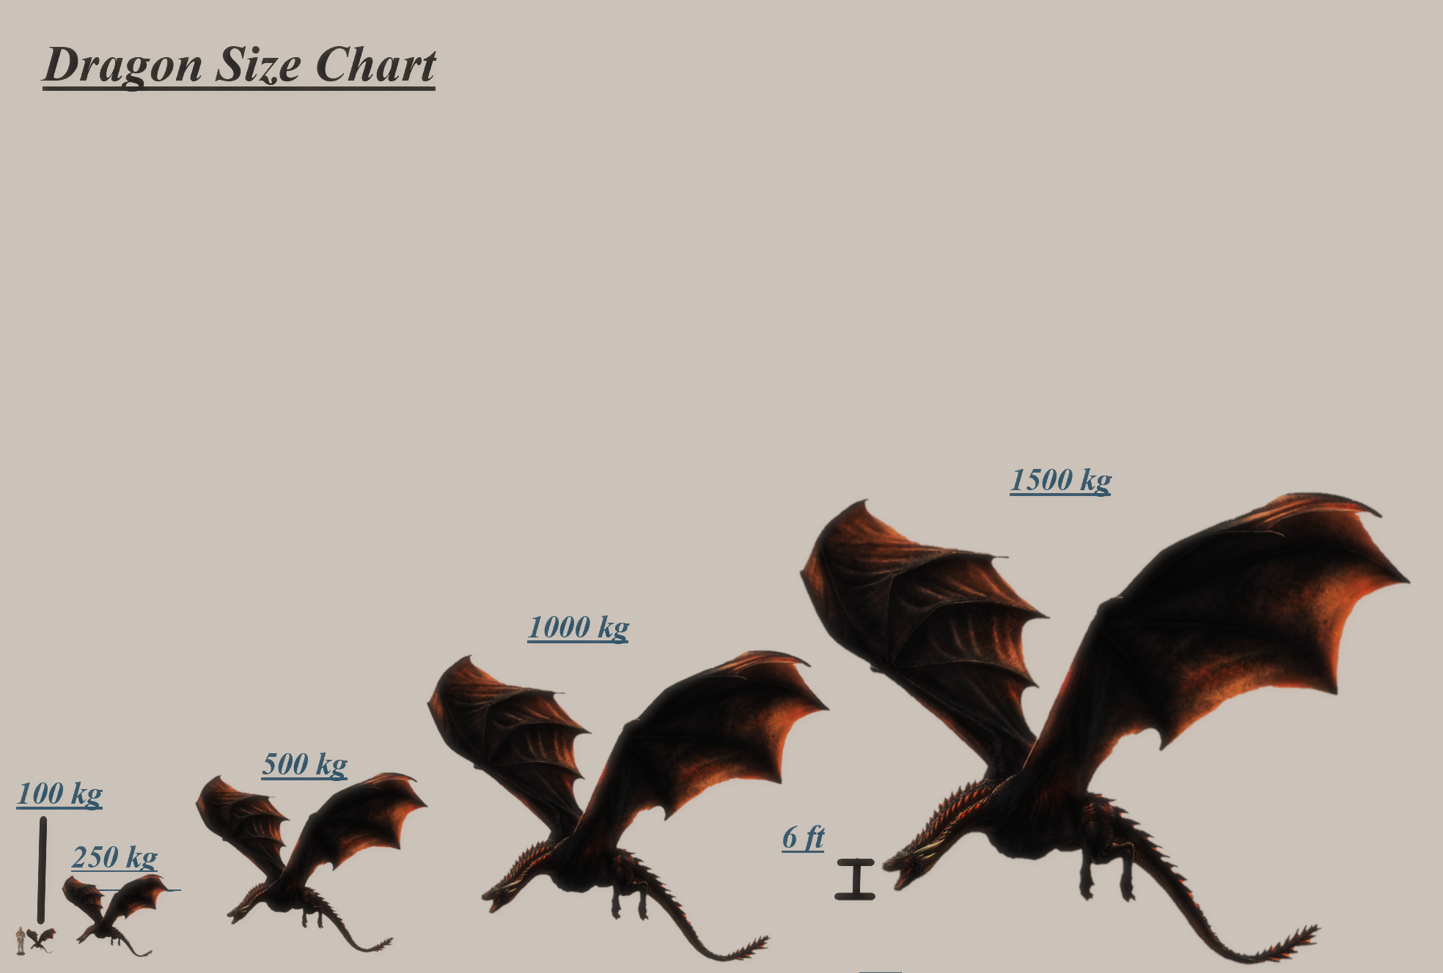
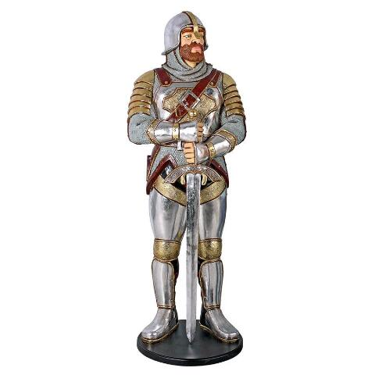
This is a 6 ft tall person in comparison with the dragons

Slide 7
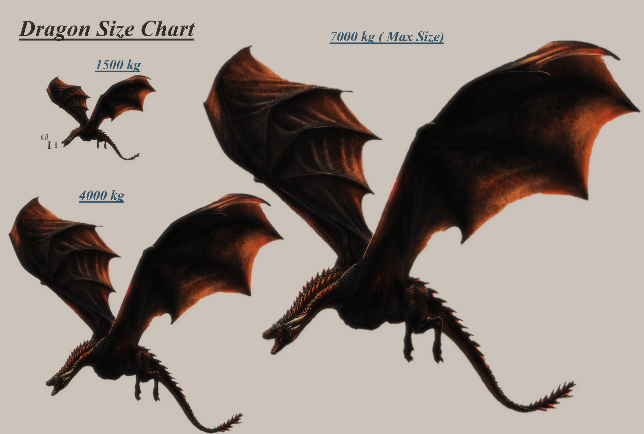

Slide 8
Linear Growth Model
Assumptions:
The dragons grow at a linear rate over time, K(t) = kg at time t
Best case- K(t)= 175*t +10
Average case - K(t)= 70*t +10
Worst Case - K(t)= 25*t +10
*These growth rates are extrapolated from data found in The World of Ice and Fire by GRRM

Slide 9
Constant Growth Rate
Assumptions:
The dragon grows with a constant rate with respect to its own weight
It varies between a great , average, and worst case
This model is not very good and doesn’t approximate the dragons well

Slide 10
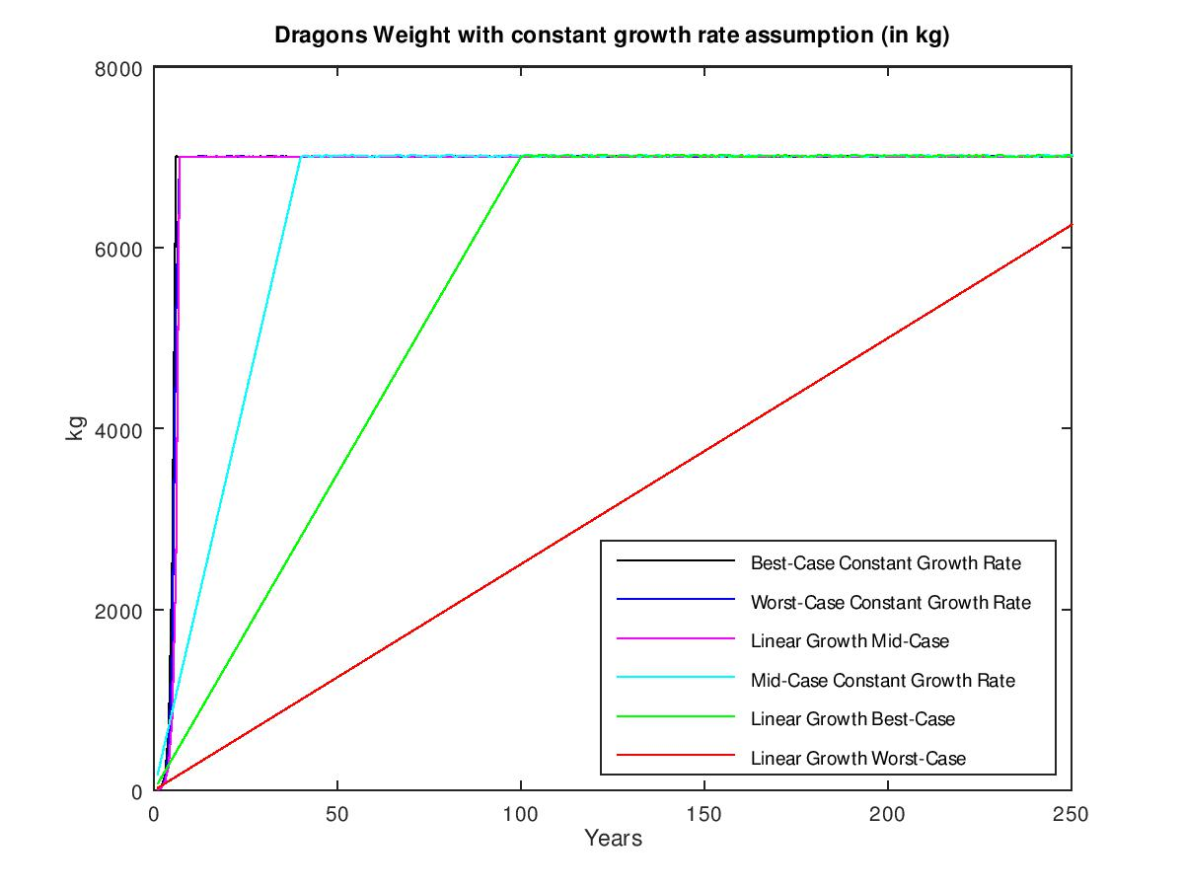
*(Some of these are mislabeled)

Slide 11
Linear Growth with Stochasticity
Assumptions:
K(t+1)=r*(t+1)+K(t), K(t) is kg at time t
r has 5 cases
Great: r=2, ¼ chance
Good: r=1, 0.15 chance
Average: r=0.85, 1/5 chance
Bad: r=0.6, 0.15 chance
Worst: r=0.15, 1/4th chance

Slide 12
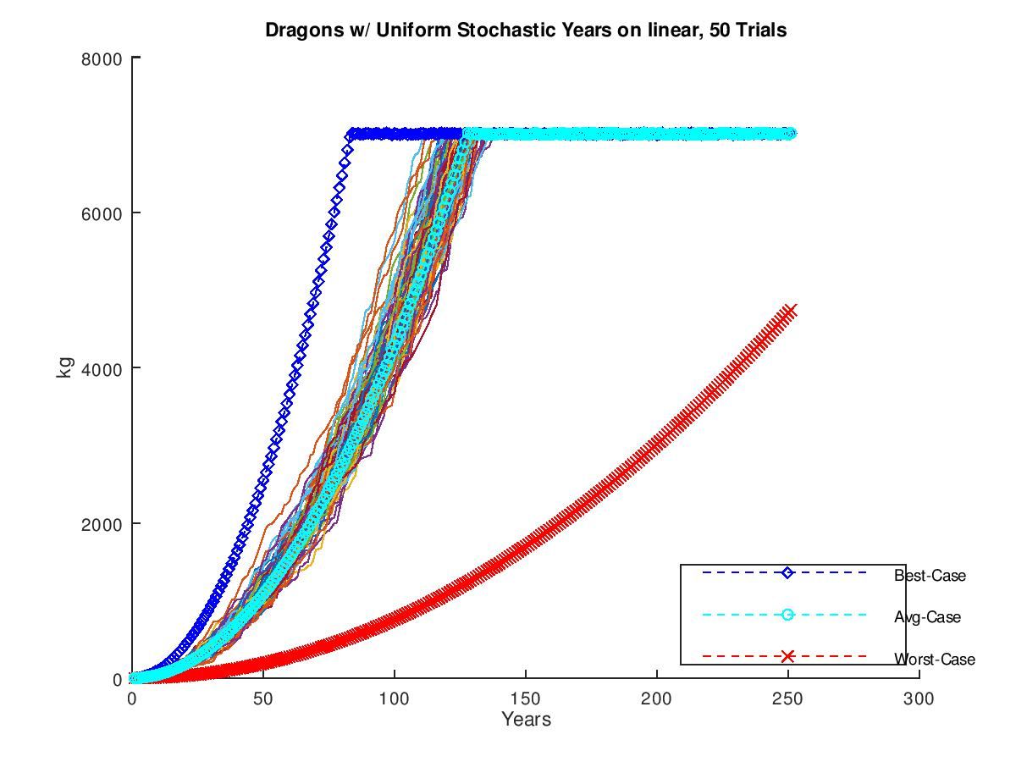

Slide 13
Logistic Growth without Magic
Assumptions:
K(t+1)=K(t)+K(t)*r*(1-(K(t)/7000))+10 , K(t) is kg at time t
Based on Logistic equation, with stochastic years
5 Year cases for r all with 1/5 chance
Great, r=0.15
Good, r=0.11
Average, r=0.08
Bad, r=0.05
Worst, r=0.01

Slide 14
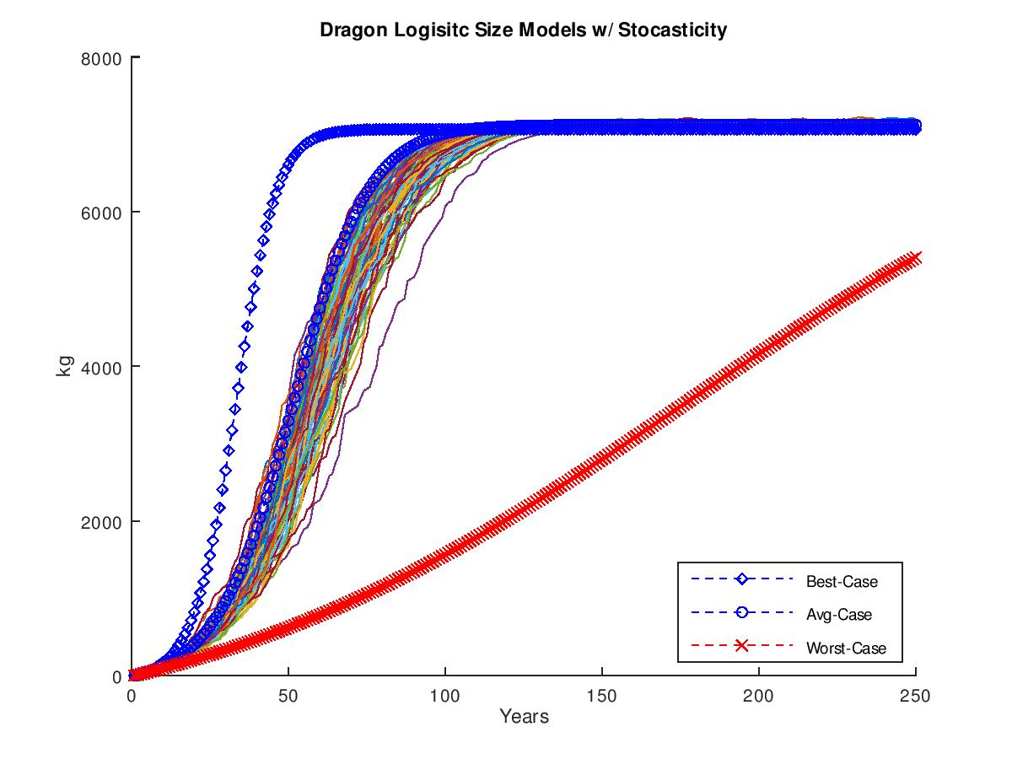

Slide 15
Age-Based Model
Assumptions:
K(t+1)==K(t)+K(t)*(r/t)+10 , K(t) is kg at time t
This model is based on the idea that the capacity for growth increases with the size of the animal, therefore the growth-rate will increase as the animal increases in size
For the trials 5 cases of r are used
Great, r=1.48
Good, r=1.32
Average, r=1.15
Bad, r=0.96
Worst, r=0.85

Slide 16
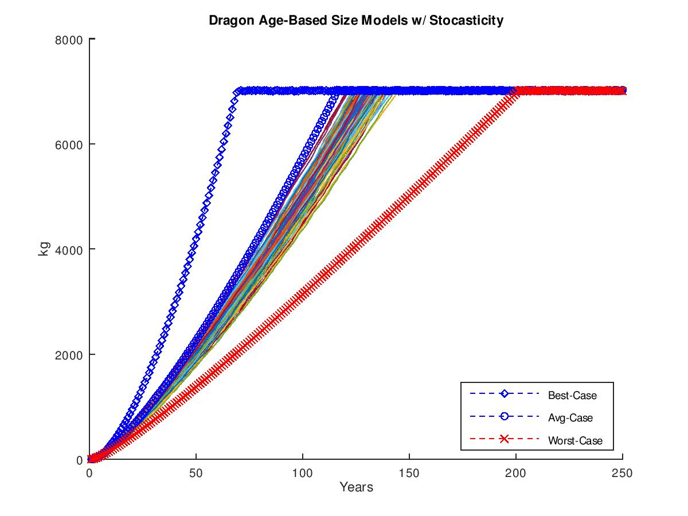

Slide 17
Particle Position Model
Assumptions:
K(t+1)=K(t)+t*r*(1-(K(t)/7000))+10 + M
Assumes Dragons growth can be modeled by a trajectory, With a changing kg given with a velocity of growth and acceleration of growth
Magical Acceleration factor that changes every 10 years, 3 cases for M
M=5.4*(t^2), Magical surge
M=0 , no magic
M=-0.0001*sqrt(t) , Magic Death
5 Case Growth rates for r
Great, r=1.48
Good, r=1.32
Average, r=1.15
Bad, r=0.86
Worst, r=0.62

Slide 18
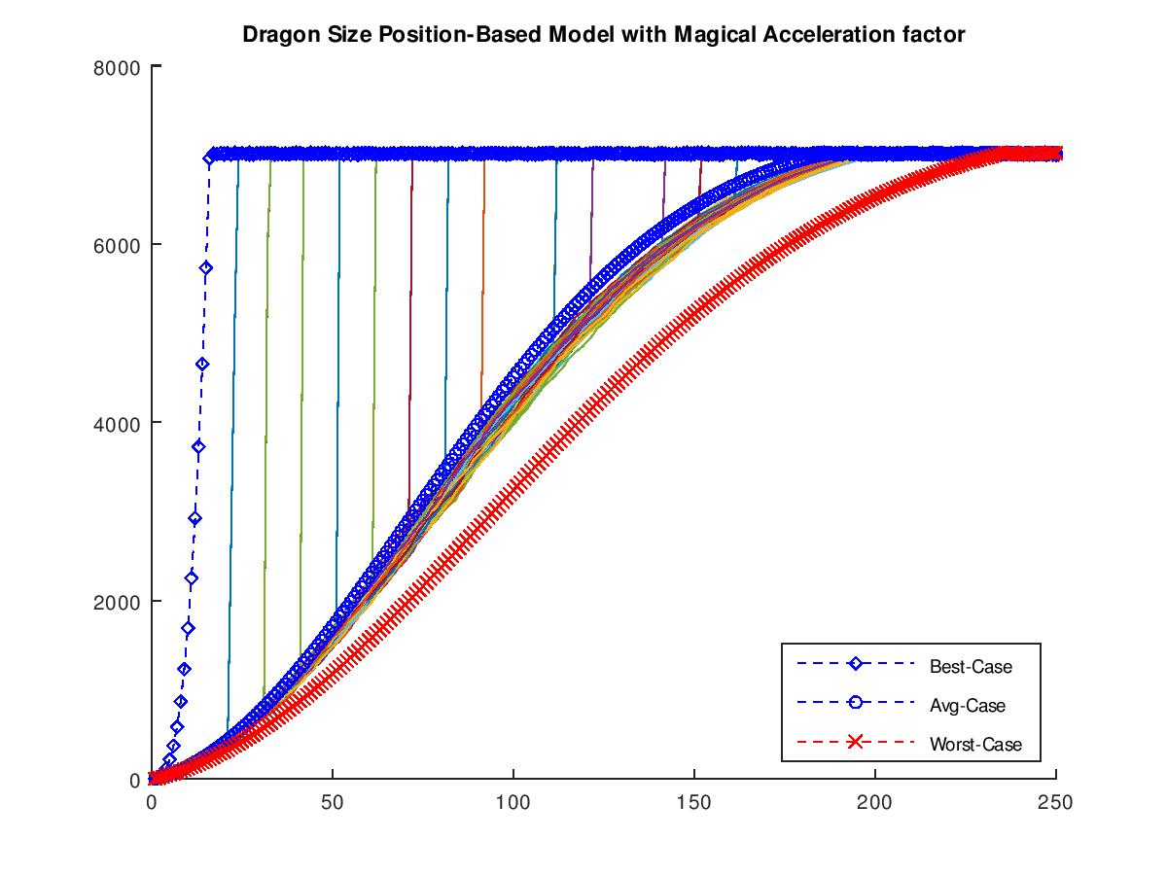

Slide 19
Logistic Model with Magic Factor
Assumptions:
K(t+1)=K(t)+K(t)*r*(1-(K(t)/7000))+10
This is the same model as the Logistic model spoken about before except we have changed the r to compensate for magic in the world.
These magic models are needed to explain the growth of the dragons in the show, as they grow at unreasonable rates
r has 5 cases all equally likely
Great, r=0.45
Good, r=0.15
Average, r=0.04
Bad, r=0.02
Worst, r=0.01

Slide 20
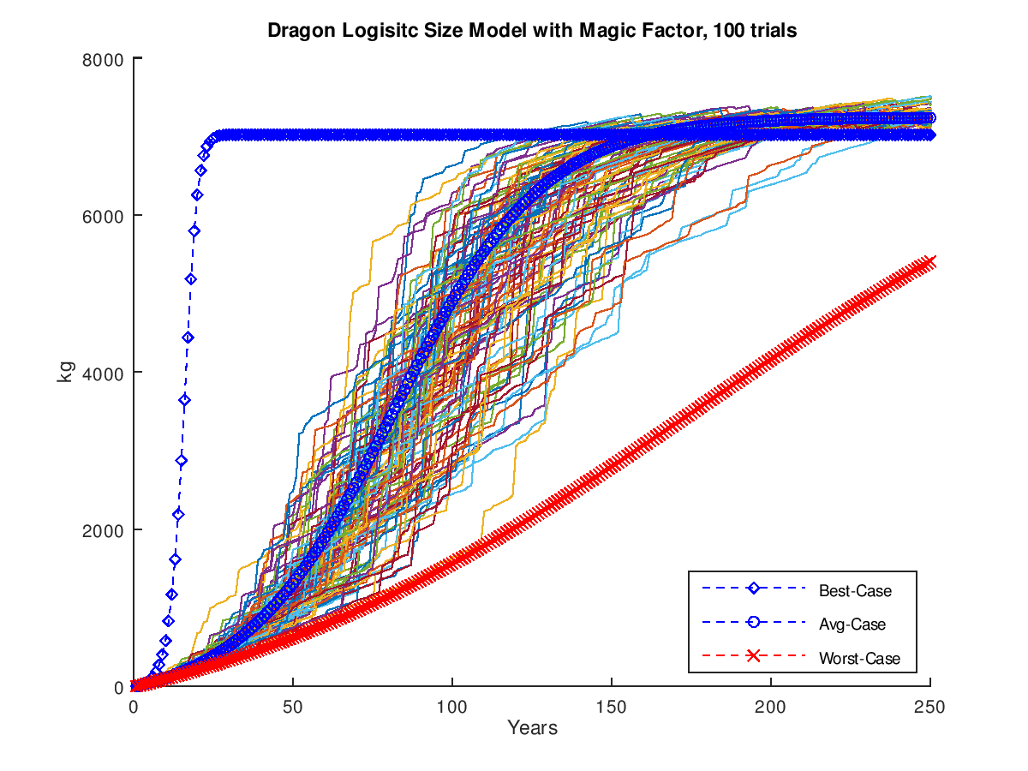

Slide 21
Conclusions for Size Model
We will continue forward assuming that the dragons grow with the Logistic sizing model with magical growth factor, since it has the prettiest graph.
Using the sizing chart we can extrapolate to Caloric needs per year for the dragon, and then estimate Caloric needs per week, for best average and worst cases.
We are assuming the dragons do not die from starvation but rather hibernate until the time to eat if need be.

Slide 22
Dragon Caloric Needs
Using data based on Tyrannosaurus Rex estimates, we will estimate that a dragon would require (73 kCal /15 kg of body weight) *
Using this information we can make a chart to show caloric needs per year for the trials
*This is based upon
https://what-if.xkcd.com/78/

Slide 23
